Slide 1
Lending Club Fraud Detection
- Group 10

Slide 2
Why build Fraud Detection Model?
Maximize Profit
Risk Management

Slide 3
Lending Club
P2P lending company
Headquartered in San Francisco
Provide alternative lending to traditional financial institutions
Dataset: 2018 Q2 data on all loans issued provided by Lending Club

Slide 4
Percentage of Fraud

Slide 5
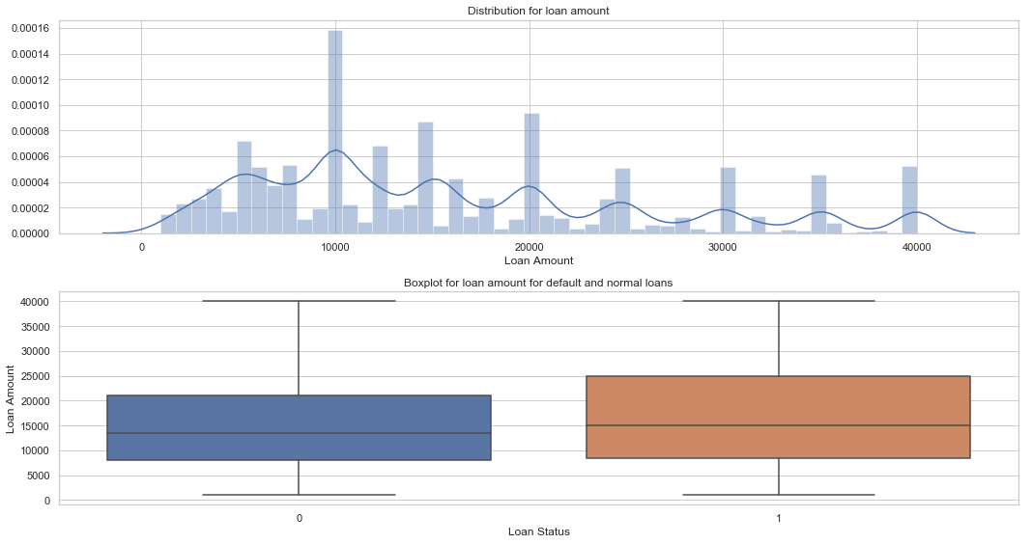
Loan Amount

Slide 6
EDA
First bullet point here
Second bullet point here
Third bullet point here
Class | Group A | Group B
Class 1 | 82 | 95
Class 2 | 76 | 88
Class 3 | 84 | 90

Slide 7
Data Preprocessing
Missing Value Imputation
Feature Engineering
Feature Selection
Remove irrelevant
Wrapper: Recursive Feature Elimination
Filter: Pearson correlation based
Embedded: Random Forest for feature ranking

Slide 8
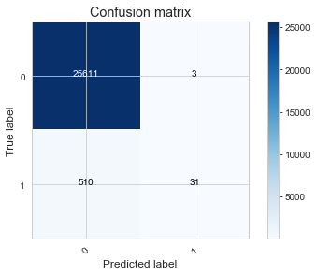
Model Building
Baseline Model
Problem: Class unbalance
Precision = 0.912
Recall (TPR) = 0.057
Fallout (FPR) = 0.000
Solution:
Over-sampling: SMOTE
Under-sampling

Slide 9
SMOTE
Synthetic Minority Over-sampling Technique

Slide 10
Logistic Regression/Regularization

Slide 11
Boosting Model

Slide 12
SVM/Kernal SVM

Slide 13
Recommendation
Under-sampling
Other missing value imputation method (KNN, median)
More sophisticated model: Neural Net, etc…
Feature Engineering
Parameter Tuning

Slide 14
Thank you!

Slide 15
Two Content Layout with SmartArt
Group A
Task 1
Task 2
Group B
Task 1
Task 2
Group C
Task 1
First bullet point here
Second bullet point here
Third bullet point here

Slide 16
Add a Slide Title - 1

Slide 17
Add a Slide Title - 2

Slide 18
Add a Slide Title - 3

Slide 20
Add a Slide Title - 4

Slide 21
Add a Slide Title - 5

